Slide 1


A Global Consortium Working to Secure Critical Infrastructure

Slide 2


About ISA
70%
N. America
8%
Europe
The leading professional
society for automation with
13,800+ members in 104 countries
12.8%
Asia Pacific
5.2%
Mid. East, Africa
3.6%
LatAm, Caribbean
138
16
8
8K
10K
Standards
Personnel
Credentials
Product & System Certifications
Professionals
Trained (2022)
Event
Registrants (2022)
Membership | Training | Certification | Events
Standards | Conformity Assessment | Publications

Slide 3






Overview: ISA/IEC 62443 Standards
The world’s only consensus-based automation and control systems security standards
ISA/IEC 62443 standards address OT in 16 CI sectors, non-telecom & finance
The ISA99 committee was formed in 2002 and works closely with IEC Technical Committee 65
ISA/IEC 62443 standards contain over 500 normative requirements that address all phases of the system life cycle
ISA/IEC 62443 are the most referenced standard in the NIST Cybersecurity Framework
Over 1,500 volunteer members represent a wide range of industry sectors and constituencies from all areas of the world
Formal and informal liaison relationships with IEC, OPAF, NAMUR, WIB, NIST, DHS, INL, ISASecure, and ISAGCA

Slide 4
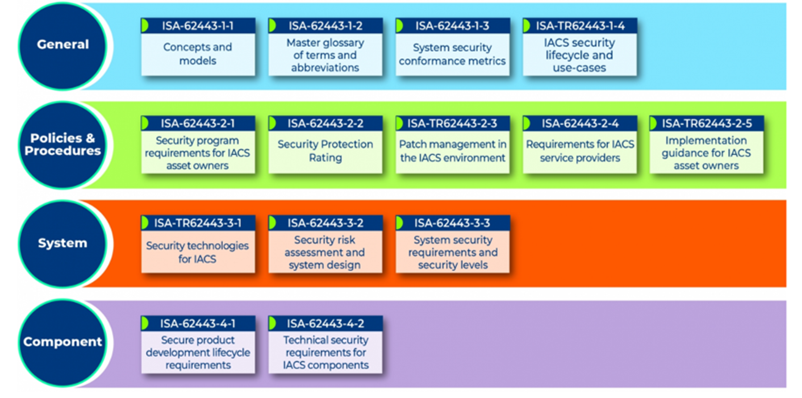
Goal: ISA/IEC 62443 Standards
Improve the safety, reliability, integrity, and security of Industrial Automation and Control Systems (IACS) using a risk-based, methodical, and complete process throughout the entire lifecycle
    Describes a set of common terms and requirements that can be used by asset owners, product suppliers, and service providers
    IACS includes collection of personnel, hardware, software and policies involved in operation of industrial processes that can affect its safe, secure, and reliable operation
    Provides comprehensive set of guidelines for securing IACS used in various industries, including manufacturing, energy, critical infrastructure, medical devices and transportation sectors.

Slide 5




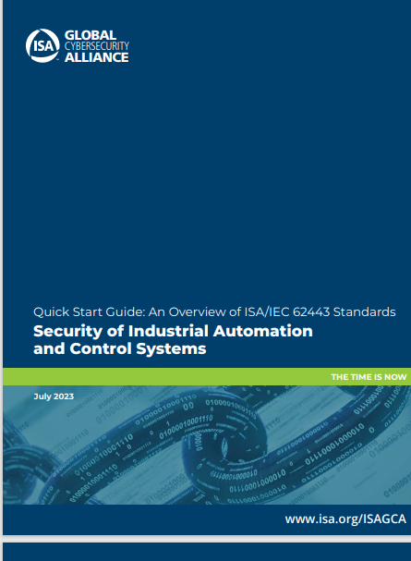

Value: ISA/IEC 62443 Standards
    Structured Approach to Operational Technology (OT) Security: ISA/IEC 62443 protects against cyber threats and ensure the reliability, safety and integrity of industrial operations.
    Global Consistency: ISA/IEC 62443 is an international standard, which is a common framework that can be adopted by organizations worldwide. Both supplier organizations and asset-owner organizations operate globally and benefit from conformance to a single international standard.
    Risk Mitigation: ISA/IEC 62443 standards help organizations assess and mitigate the risks associated with cyber attacks on their industrial control systems. They provide a structured approach to identifying vulnerabilities and implementing measures to protect against threats.
    Vendors and Supply Chain: These standards provide guidance on cybersecurity
    when procuring and integrating control systems from different vendors. This
    helps ensure security is built into the supply chain.
    Compliance and Certification: Requiring compliance to ISA/IEC 62443
    demonstrates cyber readiness. Conformity assessment programs like ISASecure
    have been available for 13 years, providing transparency for asset-owner
    procurement activities and operational security status.
Free Resource available: Quick Start Guide:
An Overview of ISA/IEC 62443 Standards
Security of Industrial Automation and Control

Slide 6
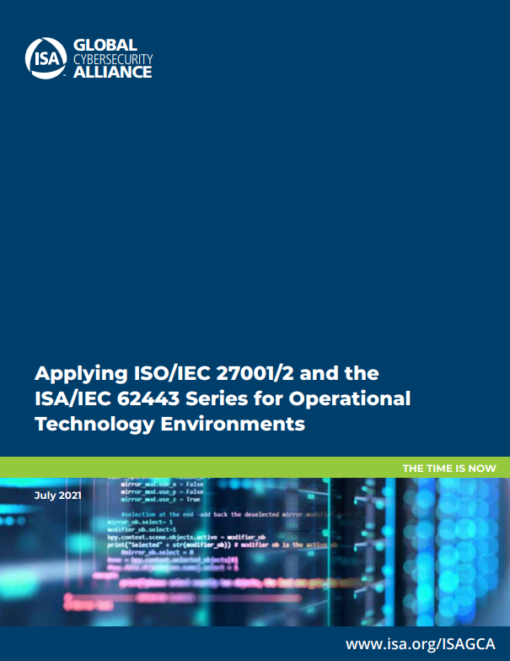

Working Together:
ISA/IEC 62443 and ISO/IEC 27001/2
Is 27K sufficient to address the OT infrastructure?
What are the differences and commonalities between 27K and 62443?
What is the added value of 62443 for the protection of operating facilities?
How can both standards be combined in the OT environment?

Slide 7

Working Together:
ISA/IEC 62443 and ISO/IEC 27001/2
Information security
of an organization
ISO/IEC 27001/2
address
IT infrastructure
(Office environment)
OT infrastructure of operating facilities (IACS*)
address
ISA/IEC 62443 series
*IACS: Industrial Automation and Control System
27001 and 62443 address two aspects of a
holistic cybersecurity strategy of an organization
Free Resource available: Applying ISA/IEC 27001/2 and the ISA/IEC62443 Series for Operational Technology Environment

Slide 8

According to ISA/IEC 62443-2-1, the Security Program of Asset Owner and ISMS Must Be Coordinated
IACS environment
IT environment of IACS in operation
Industrial Automation and Control System (IACS)
Asset Owner
Accountable
operates
Process security measures
to be practiced during operation
ISO/IEC 27001/2
Information security management system
Automation solution
IEC 62443-2-1
Security program requirements for IACS for asset owners
Source:https://assets.new.siemens.com/siemens/assets/
Asset Owner has an established ISMS for the IT environment according to ISO/IEC 27001/2
Asset Owner operates a security program for the IACS in operation according to IEC 62443-2-1
Requirements of IEC 62443-2-1 are specific to IACS and must be matched to ISO/IEC 27001/2 controls

Slide 9




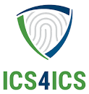
ISA Global Cybersecurity Alliance
  Mission: Bridge the gap between the published ISA/IEC 62443 automation cybersecurity standards and adoption by stakeholders including end-users, suppliers, service providers, and public policy makers.
Vision: Establish a forum for collaboration among stakeholders to develop programs and work products that accelerate adoption of cybersecurity best practices for securing automation that affects our everyday lives.
Awareness and Outreach – Generate awareness of ISA/IEC 62443 and value of the standards and practices through participation at industry events, presentations, webinars, social media, and more.
Advocacy and Adoption – Recruit industry group support and advocate for adoption in public policy language with regulatory authorities, legislators, and the insurance industry.
Training and Education – Develop new ISA cybersecurity education offerings, collaborate with academia and government (such as INL, DHS, CISA), update commercial and open-source tools, and improve accessibility to ISA/IEC 62443 standards and practices.
Compliance and Prevention – Establish an incident response capability through the ICS4ICS program. www.ics4ics.org
Notes:
Created by the International Society of Automation (ISA), the world’s leading society for automation professionals

Slide 10
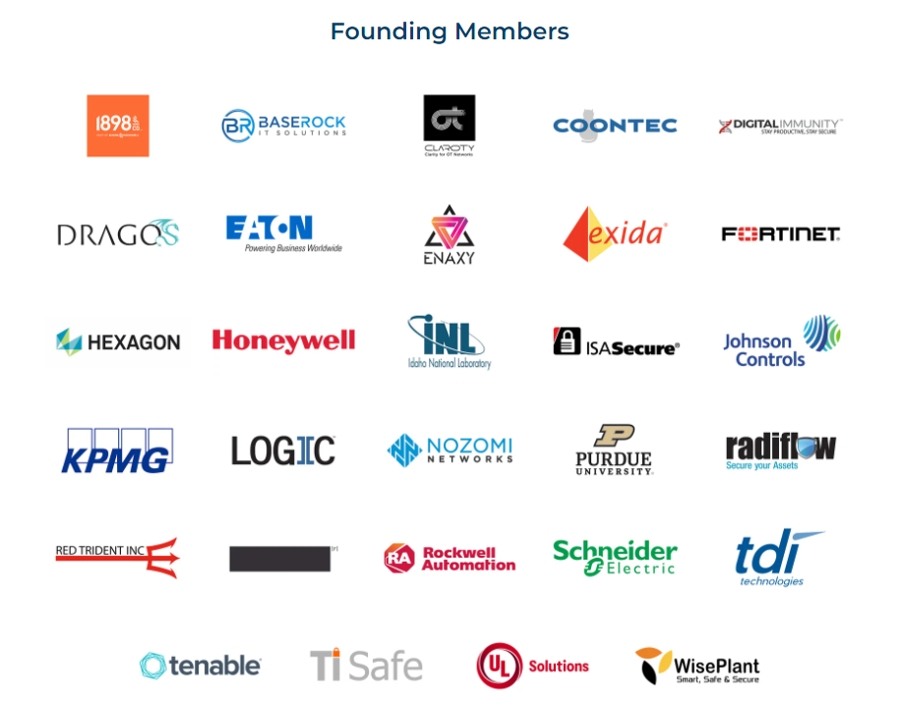
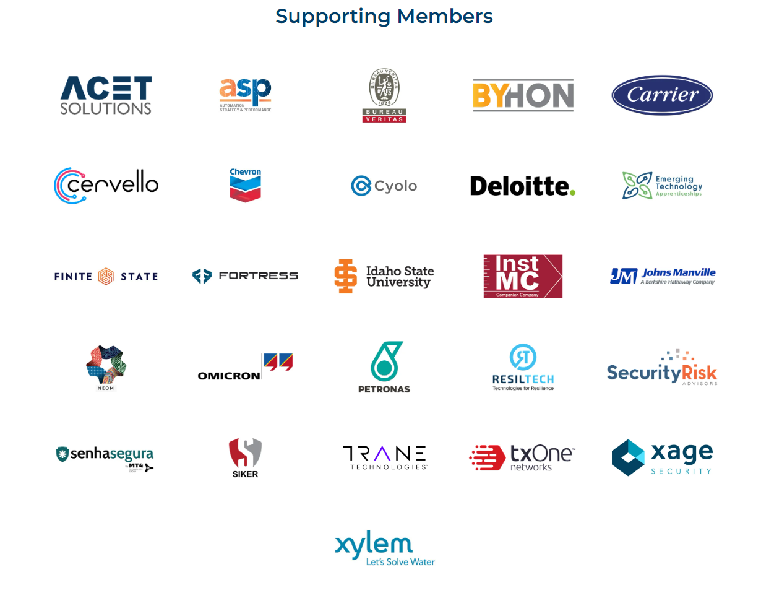
ISAGCA Members
50+
$1.5 T
2,400
31
www.isagca.org/join
Members
Aggregate revenue
Locations
Industries

Slide 11
ISA Cybersecurity Resources
Free Cybersecurity resources:
  ISA Global Cybersecurity Alliance - https://isagca.org/ Free resources
  ISASECURE Product Conformance to ISA/IEC62443 standards https://www.isasecure.org/en-US/ Free resources
  Cybersecurity incident command system for industrial control systems www.ics4ics.org Free resources
To learn more about ISA/IEC62443 visit:
  ANSI/ISA62443 Standards available from ISA: ISA/IEC 62443 Series of Standards - ISA
  ISA/IEC 62443 Training - https://www.isa.org/training-and-certification/isa-training
  OT Cybersecurity Certifications based on ISA/IEC 62443: ISASecure– https://www.isasecure.org/en-US/
  ISA99 Standards Committee – Open to any volunteer at no charge. www.isa.org/ISA99
Elevating OT cybersecurity from an art, to a science, to an engineering discipline

Slide 12
Be Part of the Movement to Prioritize OT Cybersecurity
Change the Culture
Recognize cybersecurity as a fundamental workplace tenet alongside functionality, efficiency, and safety
Learn more | www.isagca.org

