Slide 1
A Global Consortium Working to Secure Critical Infrastructure

Slide 2
About ISA
70% N. America
8%
Europe
The leading professional society for automation with
13,800+ members in 104 countries
12.8%
Asia Pacific
5.2%
Mid. East, Africa
3.6%
LatAm, Caribbean
138
16
8
8K
10K
Standards
Personnel Credentials
Product & System Certifications
Professionals Trained (2022)
Event Registrants (2022)
Membership | Training | Certification | Events
Standards | Conformity Assessment | Publications

Slide 3
Overview: ISA/IEC 62443 Standards
The world’s only consensus-based automation and control systems security standards
Adopted by governments in Taiwan, Malaysia, Saudi Arabia, Singapore, and Qatar
The ISA99 committee was formed in 2002 and works closely with IEC Technical Committee 65
ISA/IEC 62443 standards contain over 500 normative requirements that address all phases of the system life cycle
Most referenced in the NIST Cybersecurity Framework and Secure Software Development Framework, and are included in the MITRE System of Trust
Formal and informal liaison relationships with IEC, OPAF, NAMUR, WIB, NIST, DHS, INL, ISASecure, and ISAGCA
Over 1,500 volunteer members represent a wide range of industry sectors and constituencies from all areas of the world
Address OT in 16 CI sectors

Slide 4
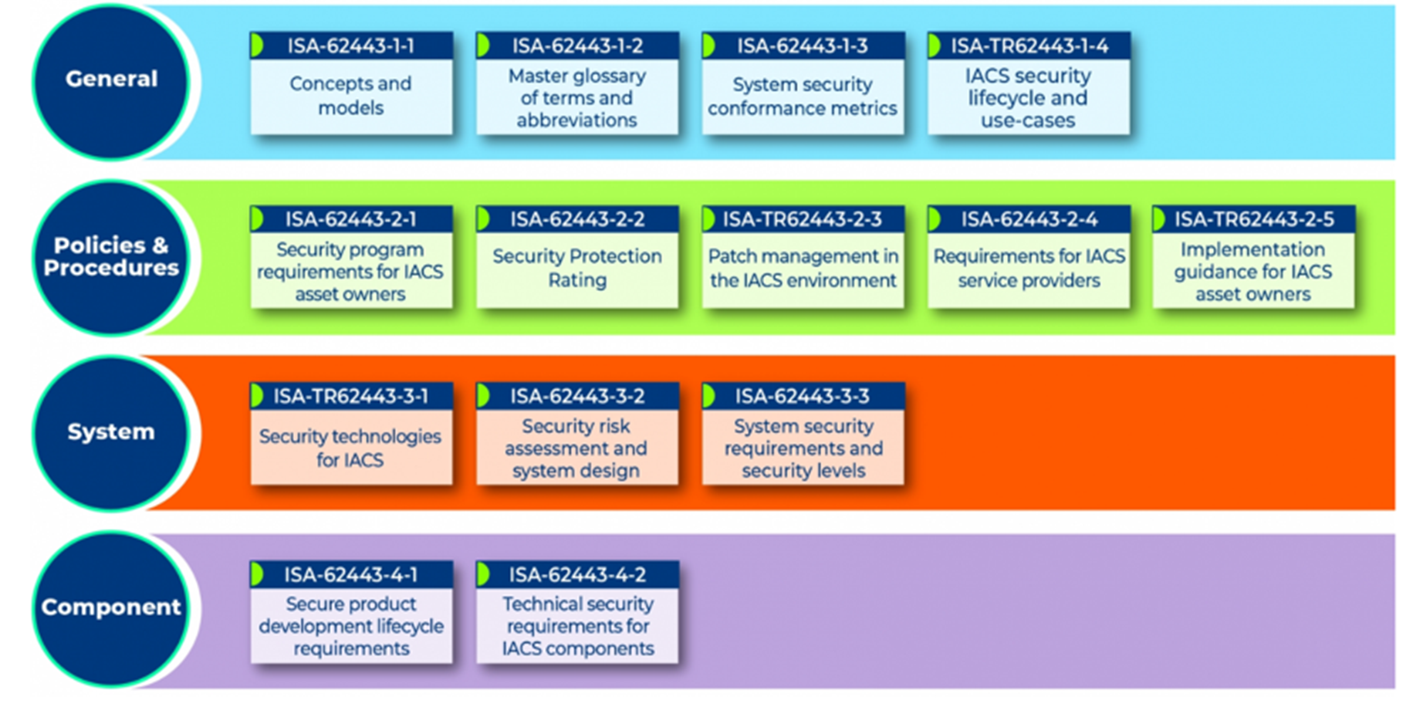
Goal: ISA/IEC 62443 Standards
Improve the safety, reliability, integrity, and security of Industrial Automation and Control Systems (IACS) using a risk-based, methodical, and complete process throughout the entire lifecycle
Describes a set of common terms and requirements that can be used by asset owners, product suppliers, and service providers
IACS includes collection of personnel, hardware, software and policies involved in operation of industrial processes that can affect its safe, secure, and reliable operation
Provides comprehensive set of guidelines for securing IACS used in various industries, including manufacturing, energy, critical infrastructure, medical devices and transportation sectors.

Slide 5
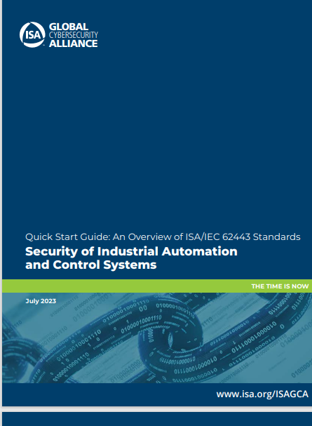
Value: ISA/IEC 62443 Standards
Structured Approach to Operational Technology (OT) Security: ISA/IEC 62443 protects against cyber threats and ensure the reliability, safety and integrity of industrial operations.
Global Consistency: ISA/IEC 62443 is an international standard, which is a common framework that can be adopted by organizations worldwide. Both supplier organizations and asset-owner organizations operate globally and benefit from conformance to a single international standard.
Risk Mitigation: ISA/IEC 62443 standards help organizations assess and mitigate the risks associated with cyber attacks on their industrial control systems. They provide a structured approach to identifying vulnerabilities and implementing measures to protect against threats.
Vendors and Supply Chain: These standards provide guidance on cybersecurity when procuring and integrating control systems from different vendors. This helps ensure security is built into the supply chain.
Compliance and Certification: Requiring compliance to ISA/IEC 62443 demonstrates cyber readiness. Conformity assessment programs like ISASecure have been available for 13 years, providing transparency for asset-owner procurement activities and operational security status.
Free Resource available: Quick Start Guide: An Overview of ISA/IEC 62443 Standards Security of Industrial Automation and Control

Slide 6
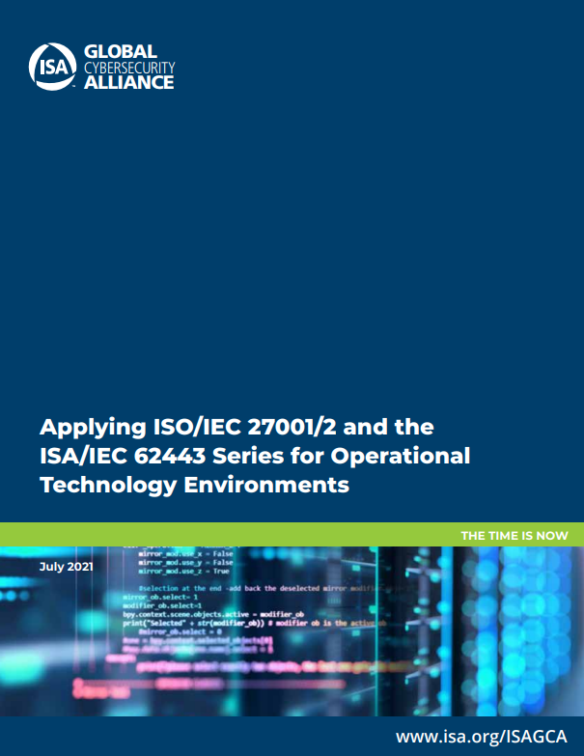
Working Together: ISA/IEC 62443 and ISO/IEC 27001/2
Is 27K sufficient to address the OT infrastructure?
What are the differences and commonalities between 27K and 62443?
What is the added value of 62443 for the protection of operating facilities?
How can both standards be combined in the OT environment?

Slide 7
Working Together: ISA/IEC 62443 and ISO/IEC 27001/2
Information security of an organization
ISO/IEC 27001/2
address
IT infrastructure (Office environment)
OT infrastructure of operating facilities (IACS*)
address
ISA/IEC 62443 series
*IACS: Industrial Automation and Control System
27001 and 62443 address two aspects of a holistic cybersecurity strategy of an organization
Free Resource available: Applying ISA/IEC 27001/2 and the ISA/IEC62443 Series for Operational Technology Environment

Slide 8
According to ISA/IEC 62443-2-1, the Security Program of Asset Owner and ISMS Must Be Coordinated
IACS environment
IT environment of IACS in operation
Industrial Automation and Control System (IACS)
Asset Owner
Accountable
operates
Process security measures to be practiced during operation
ISO/IEC 27001/2
Information security management system
Automation solution
IEC 62443-2-1
Security program requirements for IACS for asset owners
Source:https://assets.new.siemens.com/siemens/assets/
Asset Owner has an established ISMS for the IT environment according to ISO/IEC 27001/2
Asset Owner operates a security program for the IACS in operation according to IEC 62443-2-1
Requirements of IEC 62443-2-1 are specific to IACS and must be matched to ISO/IEC 27001/2 controls

Slide 9
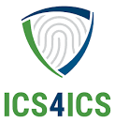
ISA Global Cybersecurity Alliance
Mission: Bridge the gap between the published ISA/IEC 62443 automation cybersecurity standards and adoption by stakeholders including end-users, suppliers, service providers, and public policy makers.
Vision: Establish a forum for collaboration among stakeholders to develop programs and work products that accelerate adoption of cybersecurity best practices for securing automation that affects our everyday lives.
Awareness and Outreach – Generate awareness of ISA/IEC 62443 and value of the standards and practices through participation at industry events, presentations, webinars, social media, and more.
Advocacy and Adoption – Recruit industry group support and advocate for adoption in public policy language with regulatory authorities, legislators, and the insurance industry.
Training and Education – Develop new ISA cybersecurity education offerings, collaborate with academia and government (such as INL, DHS, CISA), update commercial and open-source tools, and improve accessibility to ISA/IEC 62443 standards and practices.
Compliance and Prevention – Train and credential ICS incident responders and stablish an incident response capability through the ICS4ICS program. www.ics4ics.org
Notes:
Created by the International Society of Automation (ISA), the world’s leading society for automation professionals

Slide 10
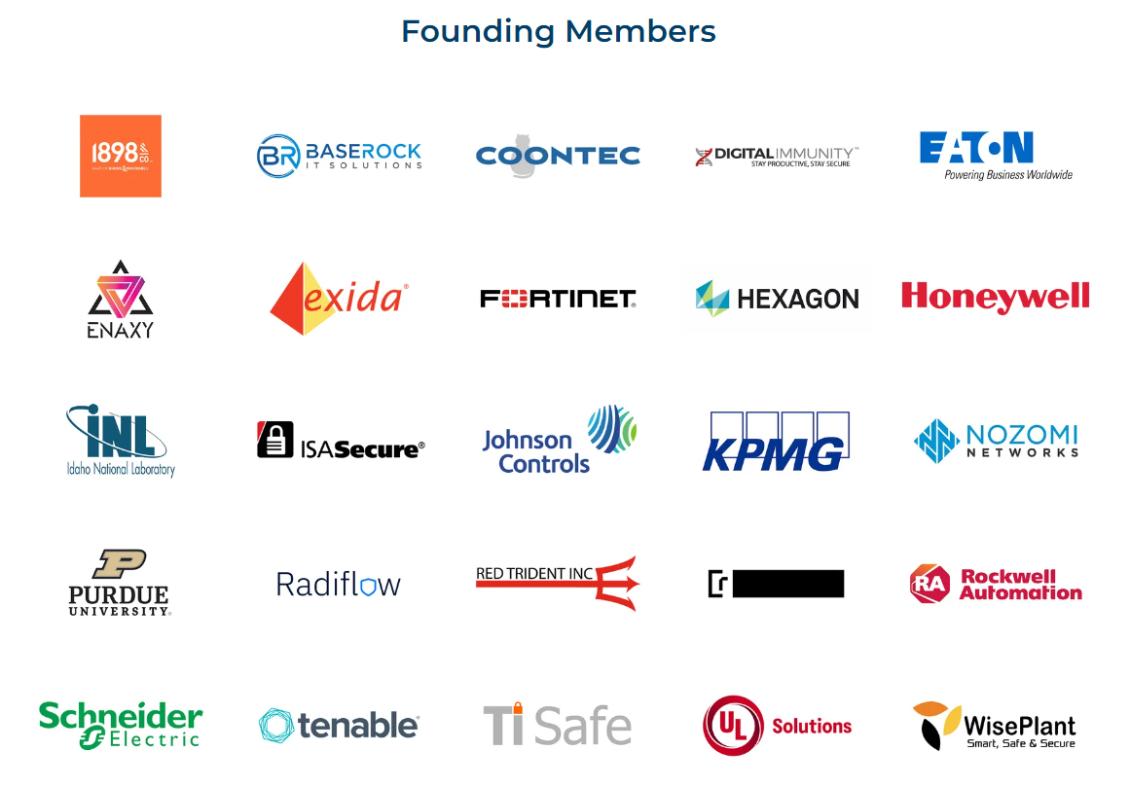
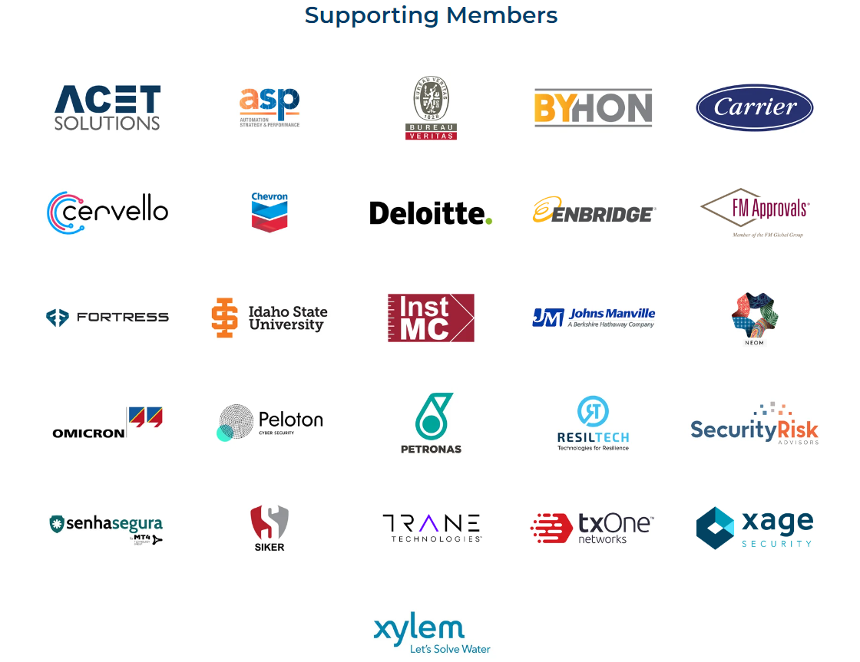
ISAGCA Members
50+
$1.5 T
2,400
31
www.isagca.org/join
Members
Aggregate revenue
Locations
Industries

Slide 11
ISA Cybersecurity Resources
Free guidance, training, and more:
ISA Global Cybersecurity Alliance - www.isagca.org A collaborative forum to advance OT cybersecurity and understanding of ISA/IEC 62443 | ISASecure www.isasecure.org The world’s leading conformance certification program for ISA/IEC 62443 | ICS4ICS www.ics4ics.org Improve how cybersecurity incidents are managed with training, processes, and exercises
Get involved:
ISA/IEC 62443 standards available from ISA (free access with ISA professional membership!)
Cybersecurity training and certificate program
Help develop the standard – open to all at no charge – www.isa.org/ISA99

Slide 12
Be Part of the Movement to Prioritize OT Cybersecurity
Change the Culture
Recognize cybersecurity as a fundamental workplace tenet alongside functionality, efficiency, and safety
Learn more | www.isagca.org

